Slide 1
Lecture 10 Linear models in R
Trevor A. Branch
FISH 552 Introduction to R

Slide 2
Course evaluation forms for FISH552

Slide 3
Background readings
Practical regression and ANOVA using R (Faraway 2002)
Chapters 2-3, 6-8, 10, 16
http://cran.r-project.org/doc/contrib/Faraway-PRA.pdf
This is an older version of the excellent book Linear Models with R by Faraway

Slide 4
Linear models
We will focus on the following equation for the classic linear model, and how to fit it
Assumption: the response Y_{i} is normally distributed
The exact method to use depends on the X_{i} predictor variables
Categorical predictors: ANOVA
Continuous predictors: Linear regression
Mixed categorical and continuous: Regression or ANCOVA

Slide 5
Goals for linear models
Estimation: what parameters in a particular model best fit the data?
Inference: how certain are the estimates and what can be interpreted from them?
Adequacy: is the model the right choice?
Prediction: over what range of values can predictions be made for new observations?
This lecture: ANOVA, linear regression/ANCOVA, model adequacy, functions to fit these models
Not covered: statistical underpinnings

Slide 6
One-way ANOVA
We have J groups. Are the means of the groups the same?
Coded as i: 1, 2, ..., n_{j} is the observation within group j: 1, 2, ..., J
H₀: µ₁ = µ₂= ... = µ_{J}
H₁: at least two of the µ_{j} values are different

Slide 7
Archaeological metals
Traces of metals found in artifacts give some indication of manufacturing techniques
The data set metals (Canvas file metals.txt) gives the percentage of iron found in pottery from four Roman-era sites
> metals <- read.table("metals.txt", header=T)
> head(metals, n=3)
Al Fe Mg Ca Na Site
1 14.4 7.00 4.30 0.15 0.51 L
2 13.8 7.08 3.43 0.12 0.17 L
3 14.6 7.09 3.88 0.13 0.20 L

Slide 8
The model statement in R
We fit the ANOVA by specifying a model
Fe ~ Site
This compact symbolic form is commonly used in statistical models in R
We have seen this symbolic form in plotting already
> plot(Fe ~ Site, data=metals)
The predictor, or independent variable
The response, or dependent variable

Slide 9
Different possible model formulae
Look up ?formula for an in-depth explanation
Some common model statements
Formula | Description
y ~ x1 -1 | - means leave something out. Fit the slope but not the intercept
y ~ x1 + x2 | model with covariates x1 and x2
y ~ x1 + x2 + x1:x2 | model with covariates x1 and x2 and an interaction between x1:x2
y ~ x1 * x2 | * denotes factor crossing, and is equivalent to the previous statement
y ~ (x1 + x2 + x3)^2 | ^ indicates crossing to the specified degree. Fit the 3 main effects for x1, x2, and x3 with all possible second order interactions
y ~ I(x1 + x2) | I means treat something as is. So the model with single covariate which is the sum of x1 and x2. (This way we don’t have to create the variable x1+x2)

Slide 10
Using aov() and summary()
The simplest way to fit an ANOVA model is with the aov() function
> Fe.aov <- aov(Fe~Site, data=metals)
> summary(Fe.aov)
Df Sum Sq Mean Sq F value Pr(>F)
Site 3 134.22 44.74 89.88 1.68e-12 ***
Residuals 22 10.95 0.50
---
Signif. codes: 0 ‘***’ 0.001 ‘**’ 0.01 ‘*’ 0.05 ‘.’ 0.1 ‘ ’ 1
Return the most important results
p-value
degrees of freedom
F statistic
quick visual guide to which p-values are significant
sum of squared differences between group means and overall mean

Slide 11
Alternative method: lm() and anova()
Instead of aov() we can first fit the model with a linear model lm() and then conduct an anova()
> Fe.lm <- lm(Fe~Site, data=metals)
> anova(Fe.lm)
Analysis of Variance Table
Response: Fe
Df Sum Sq Mean Sq F value Pr(>F)
Site 3 134.222 44.741 89.883 1.679e-12 ***
Residuals 22 10.951 0.498
---
Signif. codes: 0 ‘***’ 0.001 ‘**’ 0.01 ‘*’ 0.05 ‘.’ 0.1 ‘ ’ 1

Slide 12
More model output from lm()
> summary(Fe.lm)
Call:
lm(formula = Fe ~ Site, data = metals)
Residuals:
Min 1Q Median 3Q Max
-2.11214 -0.33954 0.01143 0.49036 1.22800
Coefficients:
Estimate Std. Error t value Pr(>|t|)
(Intercept) 1.5120 0.3155 4.792 8.73e-05 ***
SiteC 3.9030 0.5903 6.612 1.20e-06 ***
SiteI 0.2000 0.4462 0.448 0.658
SiteL 4.8601 0.3676 13.222 6.04e-12 ***
---
Signif. codes: 0 ‘***’ 0.001 ‘**’ 0.01 ‘*’ 0.05 ‘.’ 0.1 ‘ ’ 1
Residual standard error: 0.7055 on 22 degrees of freedom
Multiple R-squared: 0.9246, Adjusted R-squared: 0.9143
F-statistic: 89.88 on 3 and 22 DF, p-value: 1.679e-12
difference between data and model
t-test tests whether coefficients are significantly different from zero
how well the model fits

Slide 13
Correcting for multiple comparisons
Looking at the values from separate t-tests will increase the probability of declaring that there is a significant difference when it is not present
The most common test used that avoids this issue is Tukey’s honest significant difference test
> Fe.aov <- aov(Fe~Site, data=metals)
> TukeyHSD(Fe.aov)
expects an object that was produced by aov()

Slide 14
Results from TukeyHSD()
> TukeyHSD(Fe.aov)
Tukey multiple comparisons of means
95% family-wise confidence level
Fit: aov(formula = Fe ~ Site, data = metals)
$Site
diff lwr upr p adj
C-A 3.9030000 2.2638764 5.542124 0.0000068
I-A 0.2000000 -1.0390609 1.439061 0.9692779
L-A 4.8601429 3.8394609 5.880825 0.0000000
I-C -3.7030000 -5.3421236 -2.063876 0.0000146
L-C 0.9571429 -0.5238182 2.438104 0.3023764
L-I 4.6601429 3.6394609 5.680825 0.0000000
significant difference if these do not span zero

Slide 15
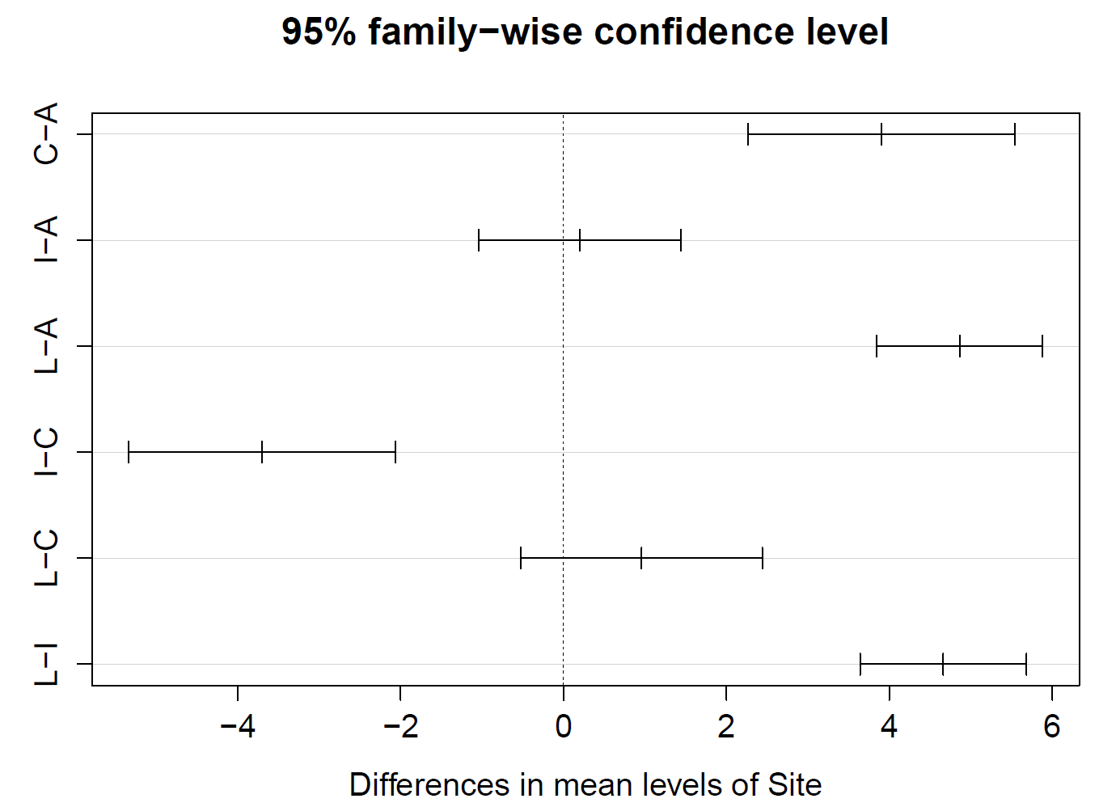
plot(TukeyHSD(Fe.aov))

Slide 16
Are model assumptions met?
In the MASS library there are many functions
Are samples independent? (Sample design.)
Normally distributed?
Histograms, qq-plots: qqplot() and qqline()
Kolmogorov-Smirnov normality test: ks.test()
Shapiro-Wilk normality test: shapiro.test()
Similar variance among samples?
Boxplots
Bartlett’s test for equal variance: bartlett.test()
Fligner-Killeen test for equal variance: fligner.test()

Slide 17
In-class exercise 1
Using the archaeological data in the ANOVA model
Extract the residuals from the Fe.lm model (hint: names)
Check for normality using the residuals (you will need the MASS package loaded for tests)
Check whether the variances are equal
Are the assumptions met?

Slide 18
ANCOVA / regression
Given a basic understanding of the lm() function, it is not too hard to fit other linear models
Regression models with mixed categorical and continuous variables can also be fit with the lm() function
There are also a suite of functions associated with the resulting lm() objects which we can use for common model evaluation and prediction routines

Slide 19
Marmot data
marmot <- read.table("Data//marmot.txt", header=T)
Does the duration of whistles change when yellow-bellied marmots hear simulated predator sounds?
> head(marmot)
len rep dist type loc
1 0.12214826 1 17.2733271 Human A
2 0.07630072 3 0.2445166 Human A
3 0.11584495 1 13.0901767 Human A
4 0.11318707 1 14.9489510 Human A
5 0.09931512 2 13.0074619 Human A
6 0.10285429 2 10.6129169 Human A

Slide 20
Marmot data
len: length of marmot whistles (response variable)
rep: number of repetitions of whistle per bout (continuous)
dist: distance from challenge when whistle began (continuous)
type: type of challenge, either Human, RC Plane, Dog (categorical)
loc: test location, either A, B, or C (categorical)

Slide 21
Exploring potential models
Basic exploratory data analysis should always be performed before starting to fit a model
Always try and find a meaningful model
When there are two or more categorical predictors, an interaction plot is useful for determining whether the effect of x1 on y depends on the level of x2 (an interaction)
interaction.plot(x.factor=marmot$loc,
trace.factor=marmot$type,
response=marmot$len)

Slide 22
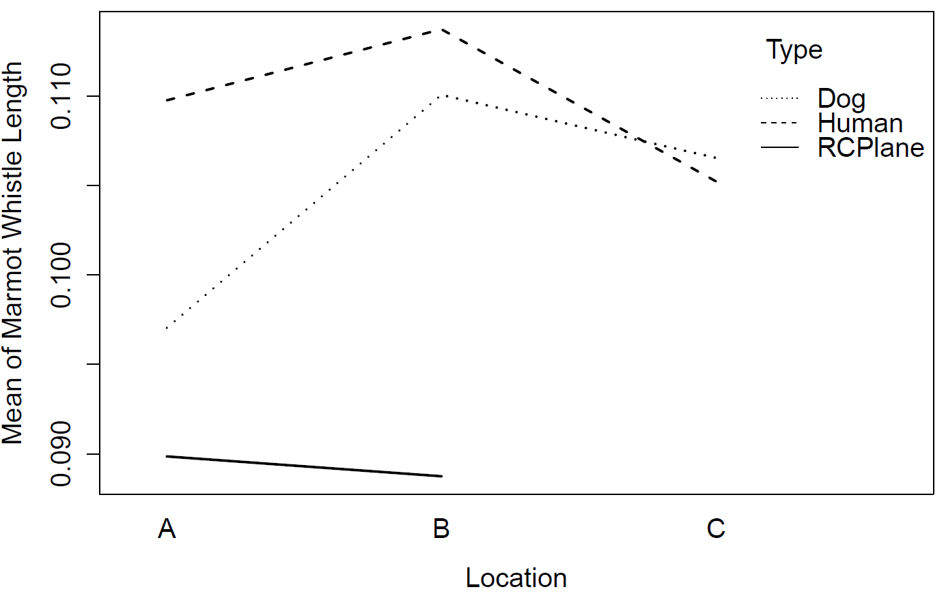
interaction.plot(x.factor=marmot$loc,
trace.factor=marmot$type,
response=marmot$len)
Slight evidence for an interaction
No RCPlane data at location C, can't find interactions

Slide 23
Exploring potential models
We can also examine potential interactions between continuous and categorical variables with simple bivariate plots conditioned on factors
> plot(marmot$dist, marmot$len, xlab = "Distance from challenge", ylab = "Length of whistles", type = "n")
> points(marmot$dist[marmot$type == "Dog"], marmot$len[marmot$type == "Dog"],pch=17, col = "blue")
> points(marmot$dist[marmot$type == "Human"], marmot$len[marmot$type == "Human"],pch=18, col = "red")
> points(marmot$dist[marmot$type == "RCPlane"], marmot$len[marmot$type=="RCPlane"], pch=19, col="green")
> legend("bottomleft", bty = 'n', levels(marmot$type), col = c("blue", "red", "green"), pch = 17:19)
set up a blank plot
quick way to extract names of categorical variables
add points

Slide 24
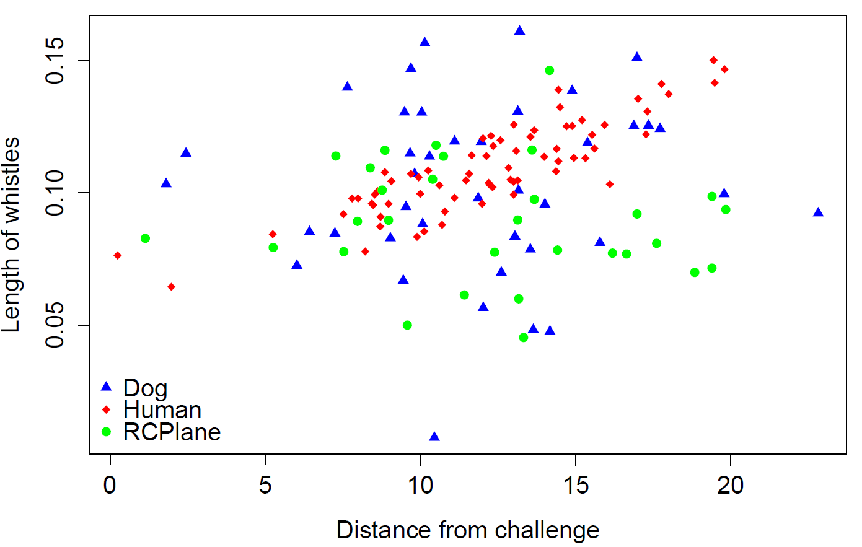

Slide 25
One potential model
Suppose that after conducting this exploratory data analysis and model fitting we arrive at this model
Length ~ Location + Distance + Type + Distance*Type
We can fit this model as follows:
> interactionModel <- lm(len ~ loc + type*dist, data=marmot)
> interactionModel Call:
lm(formula = len ~ loc + type * dist, data = marmot)
Coefficients:
(Intercept) locB locC typeHuman
0.0941227 0.0031960 0.0026906 -0.0353553
typeRCPlane dist typeHuman:dist typeRCPlane:dist
0.0001025 0.0005970 0.0034316 -0.0011266

Slide 26
> summary(interactionModel)
Call:
lm(formula = len ~ loc + type * dist, data = marmot)
Residuals:
Min 1Q Median 3Q Max
-0.09297 -0.01081 0.00103 0.01003 0.05959
Coefficients:
Estimate Std. Error t value Pr(>|t|)
(Intercept) 0.0941227 0.0106280 8.856 4.82e-15 ***
locB 0.0031960 0.0042574 0.751 0.45417
locC 0.0026906 0.0049046 0.549 0.58421
typeHuman -0.0353553 0.0136418 -2.592 0.01063 *
typeRCPlane 0.0001025 0.0153766 0.007 0.99469
dist 0.0005970 0.0008158 0.732 0.46555
typeHuman:dist 0.0034316 0.0010809 3.175 0.00187 **
typeRCPlane:dist -0.0011266 0.0011891 -0.947 0.34515
---
Signif. codes: 0 ‘***’ 0.001 ‘**’ 0.01 ‘*’ 0.05 ‘.’ 0.1 ‘ ’ 1
Residual standard error: 0.02147 on 132 degrees of freedom
Multiple R-squared: 0.2906, Adjusted R-squared: 0.2529
F-statistic: 7.723 on 7 and 132 DF, p-value: 8.208e-08

Slide 27
Extracting model components
All of the components of the summary() output are also stored in a list
> names(interactionModel)
[1] "coefficients" "residuals" "effects" "rank"
[5] "fitted.values" "assign" "qr" "df.residual"
[9] "contrasts" "xlevels" "call" "terms"
[13] "model"
> interactionModel$call
lm(formula = len ~ loc + type*dist, data=marmot)

Slide 28
Comparing models
Another potential model is the one without an interaction term. We could look at t-values to test whether each β term is zero, but need a partial F-test to test whether several predictors = 0
This is what an ANOVA model tests
H₀: reduced model
H₁: full model

Slide 29
Comparing models: ANOVA
> interactionModel <- lm(len ~ loc + type*dist, data=marmot)
> nonInteractionModel <- lm(len ~ loc + type + dist, data = marmot)
> anova(nonInteractionModel,interactionModel)
Analysis of Variance Table
Model 1: len ~ loc + type + dist
Model 2: len ~ loc + type * dist
Res.Df RSS Df Sum of Sq F Pr(>F)
1 134 0.069588
2 132 0.060827 2 0.0087608 9.5058 0.0001391 ***
---
Signif. codes: 0 ‘***’ 0.001 ‘**’ 0.01 ‘*’ 0.05 ‘.’ 0.1 ‘ ’ 1
two lm() objects given to ANOVA
evidence for the interaction term

Slide 30
Comparing models: AIC
The Akaike Information Criterion is a more sound method to use when selecting a model
In its simplest form, p is the number of parameters
The best model has the smallest AIC
The function AIC() will extract the AIC value from a linear model
Note that the function extractAIC() is different: it evaluates the log-likelihood based on the model deviance (for generalized linear models) and uses a different penalty

Slide 31
The corrected AIC, AIC_{c}
The corrected AIC takes into account both the number of parameters p and the number of data points n
As n gets large, AIC_{c} converges to AIC
AICc should always be used because AIC and AIC_{c} should yield equivalent results at large n

Slide 32
Hands-on exercise 2
Compute the AIC for the two marmot models that were fit using the AIC() function
Use the logLik() function to extract both the log-likelihood and number of parameters and then compute the AIC for the two marmot models from the equation
Compute the AIC_{c} using the equation (there is no built-in AIC_{c} function in the base package in R)

Slide 33
Checking assumptions
Based on AIC we choose the marmot model that included the interaction term between Distance and Type of learning
Model assumptions can be evaluated by plotting the model object
> plot(interactionModel)
Clicking on the plot (or going through the arrows) allows us to scroll through the plots
Specifying which= in the command allows the user to select a specific plot
> plot(interactionModel, which=2)

Slide 34
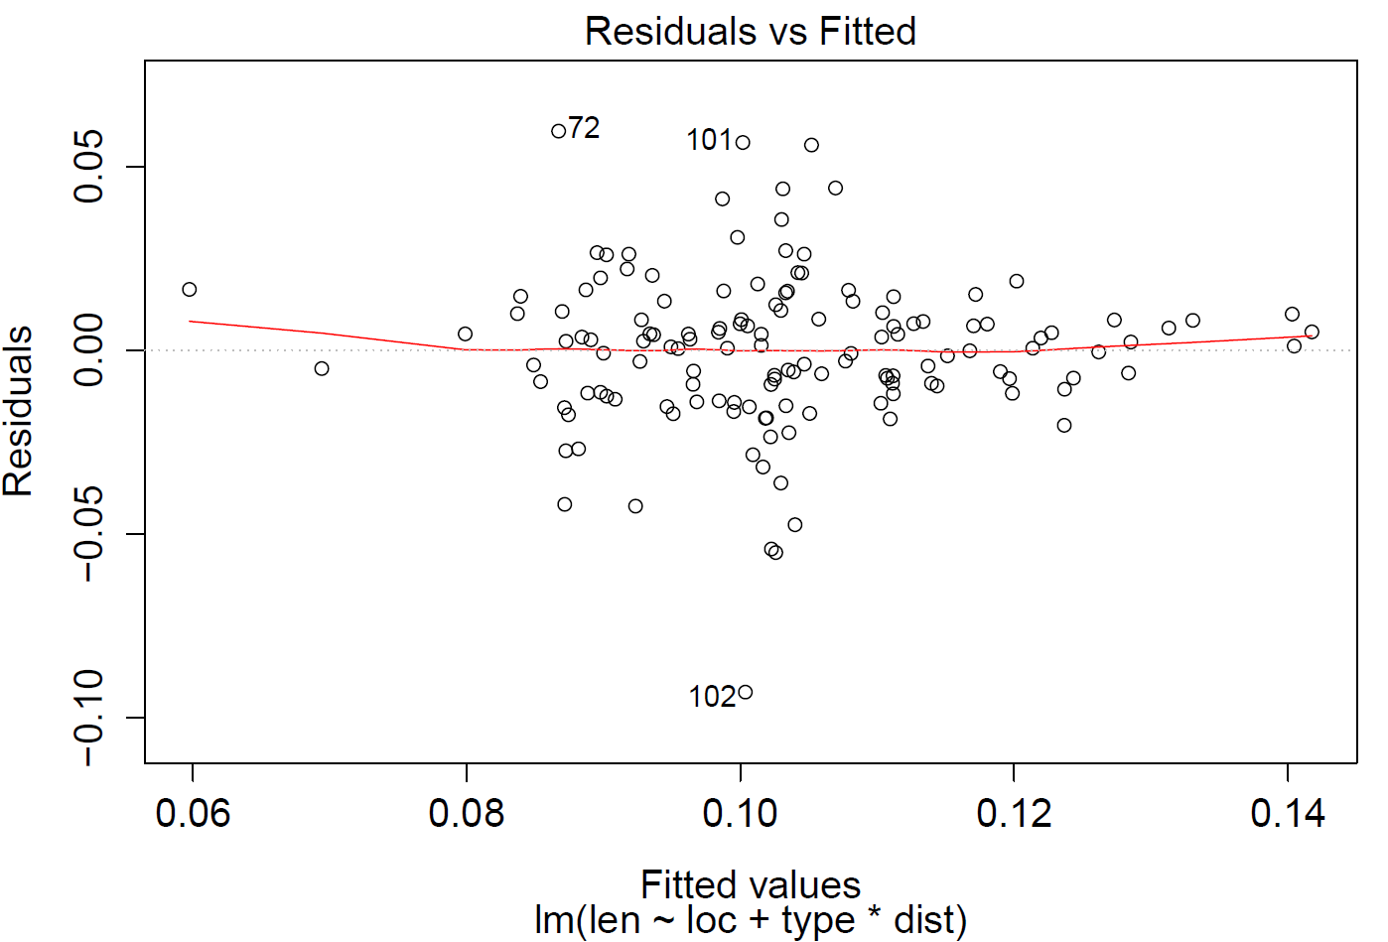
Checking the constant variance assumption
Unusual observations are flagged with numbers

Slide 35
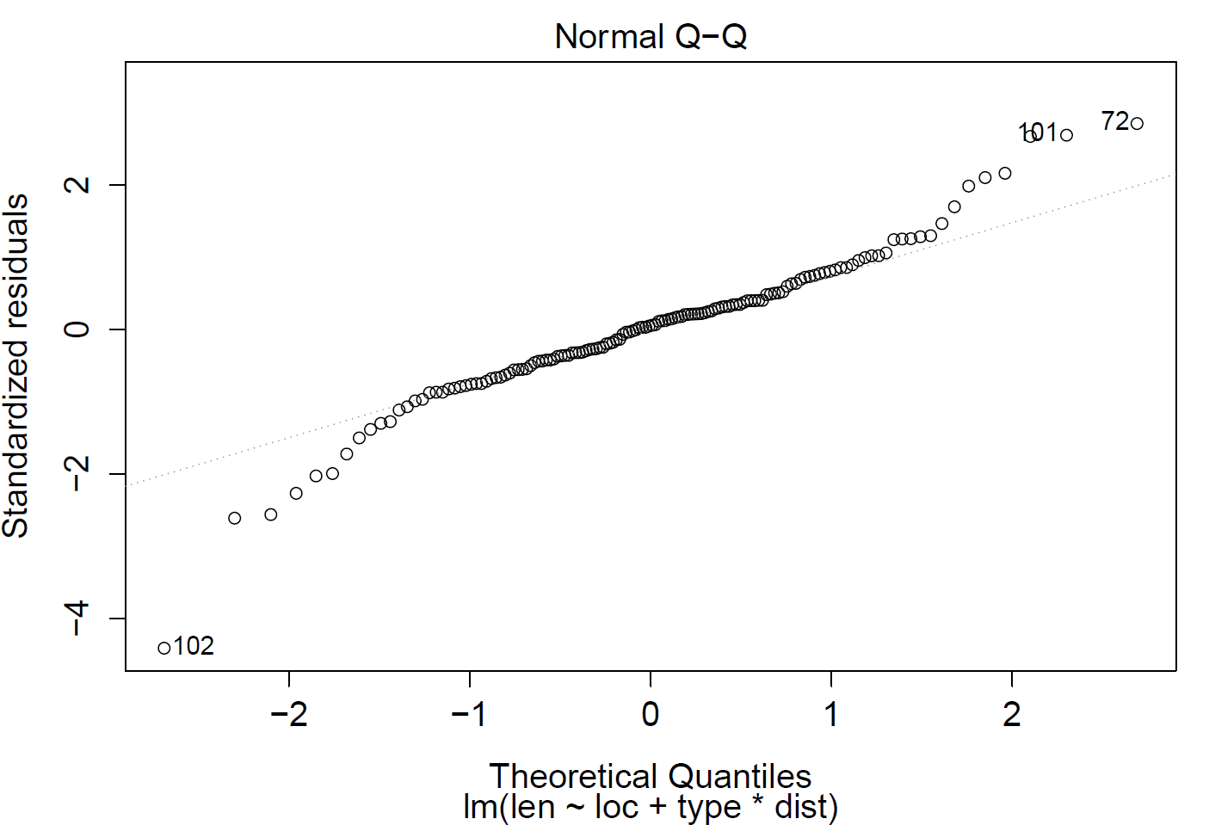
Very heavy tails, normality assumption not met

Slide 36
Parameter confidence intervals
Use the confint() function to obtain CIs for parameters
> round(confint(interactionModel),6)
2.5 % 97.5 %
(Intercept) 0.073099 0.115146
locB -0.005226 0.011618
locC -0.007011 0.012392
typeHuman -0.062340 -0.008370
typeRCPlane -0.030314 0.030519
dist -0.001017 0.002211
typeHuman:dist 0.001294 0.005570
typeRCPlane:dist -0.003479 0.001226

Slide 37
Other useful functions
addterm: forward selection using AIC
dropterm: backwards selection using AIC
stepAIC: step-wise selection using AIC
cooks.distance: check for influential observations using Cook’s distance
predict: use the model to predict future observations

Slide 38
The end of FISH552

